Slide 1



ReactForum
Thank You!!
Matt Cotter
Hokusei Gakuen University
Junior College
English Department

Slide 2
Overview
Motivation
Standard Forum Functions
ReactForum Functions
Usability

Slide 3
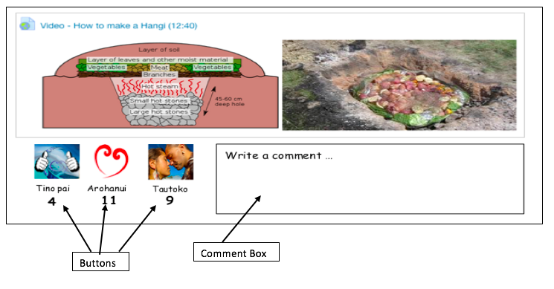
Motivation

Slide 4



Standard
Users can …….
Example :

Slide 5
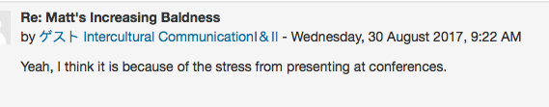
And users can …….
Example :

Slide 6

In both cases users write – usually a good thing.
But …
What if only a quick reaction or opinion is desired by clicking a button?
Why?

Slide 7

Why do we do it on Facebook?
Quickly and effortlessly we can show our…
agreement
opinion
support
emotion
Basically we can quickly and easily interact

Slide 8
The Reactforum
Agree 27
Disagree 0
Users still have reply option
Users click buttons to react
Counter tallies clicks

Slide 9
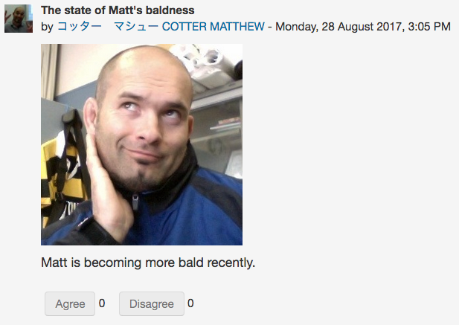
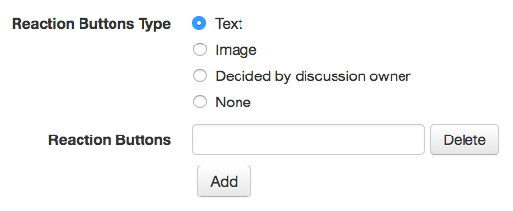
Settings
‘Text’ Buttons
Buttons can be
made using ‘text’
Type ‘text’ in here
‘text’ button
examples

Slide 10
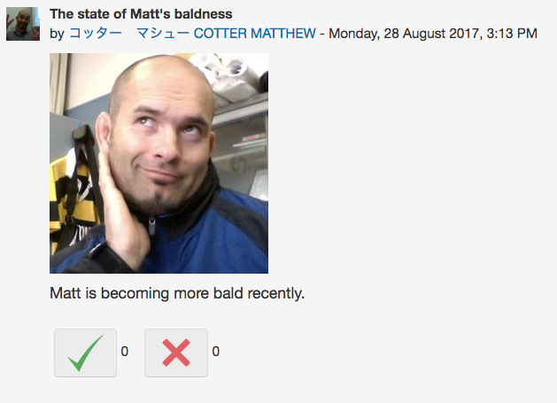
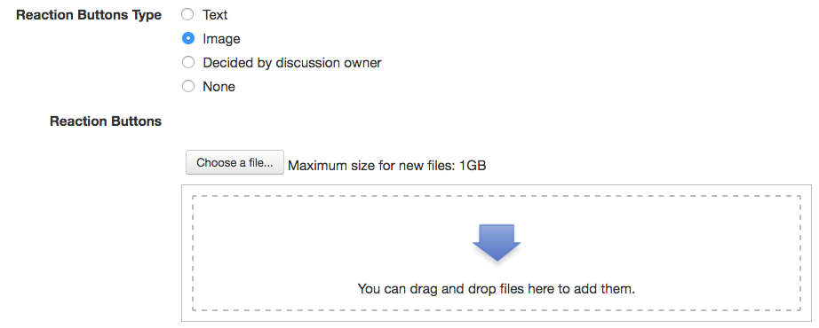
Settings
‘Image’ Buttons
Buttons can be made
using images
Drag ‘images’ here
(Automatically resizing)
‘Image’ button
examples

Slide 11
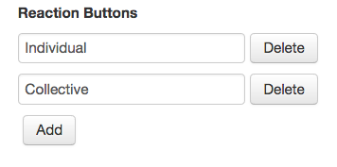
Settings
Any number of buttons can
be added. Keep adding!

Slide 12
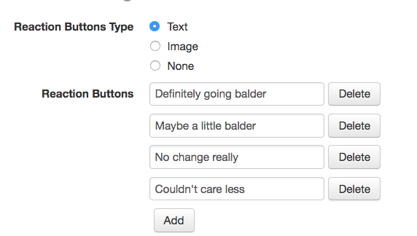
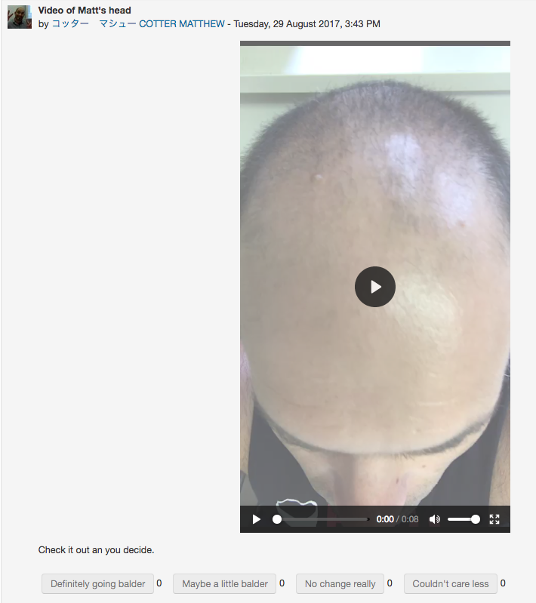
Settings
Buttons set by the teacher for the whole forum (Default)
- All discussions
use the same
buttons.

Slide 13
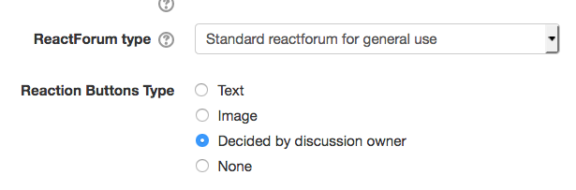
Settings
Teacher can allow
each discussion owner to
make their own buttons

Slide 14

Let’s play around on the demo page
Can think of more uses for your classes?
Matt Cotter
Hokusei Gakuen University Junior College English Department
m-cotter@hokusei.ac.jp

Slide 15
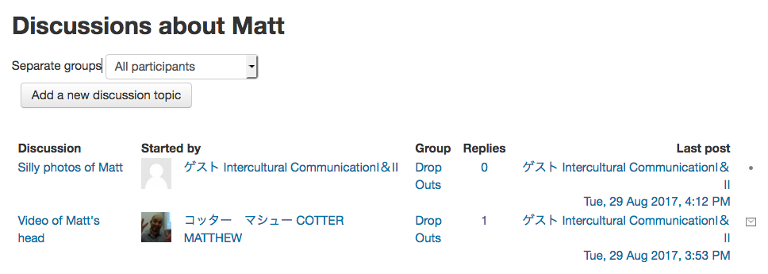
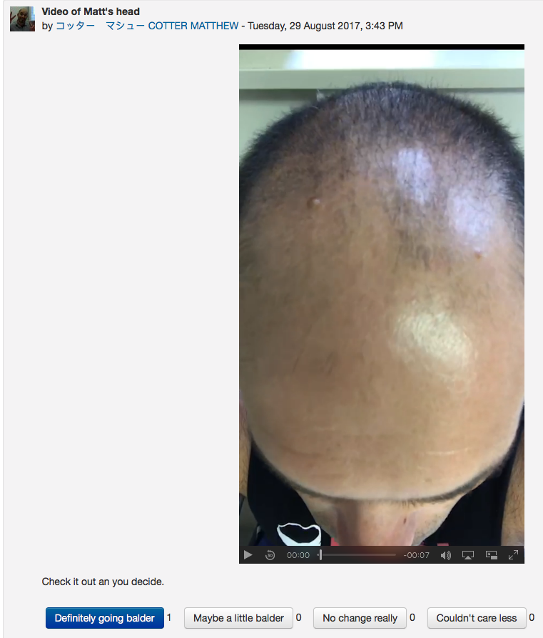
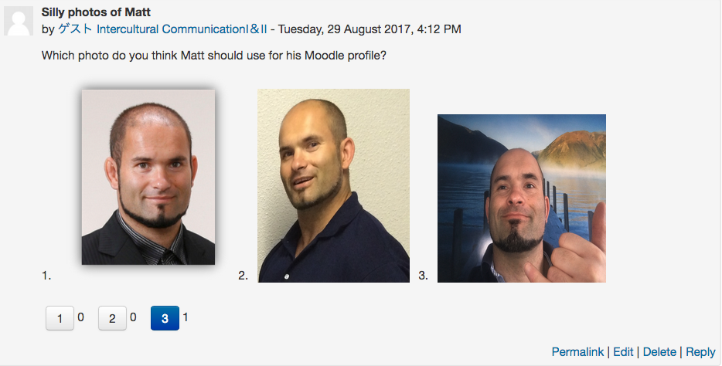
Example

Slide 16
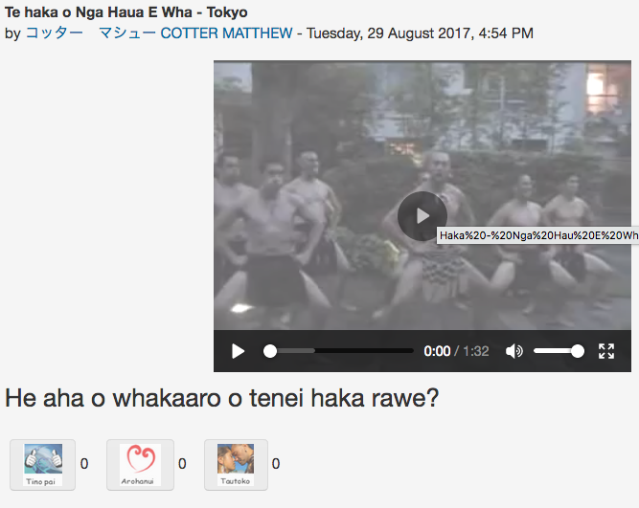
Userbility
Moodle beginners (Buy in)

Slide 17
When text or commenting is required but users need a push to write.
eg. How are you feeling now at your homestay? Click the buttons from 1 (Homesick ant want to go home) to 10 (Don't want to go back to Japan!) Next, reply with your reasons.

Slide 18
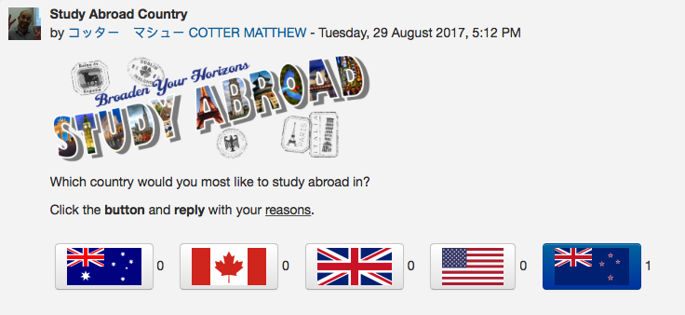
Userbility
Quick opinion surveys

