Slide 1

Allow Activity Completion Settings for Topics/Weeks
MDL-77535
Martin W. Reichel | martin.w.reichel@univie.ac.at

Slide 2
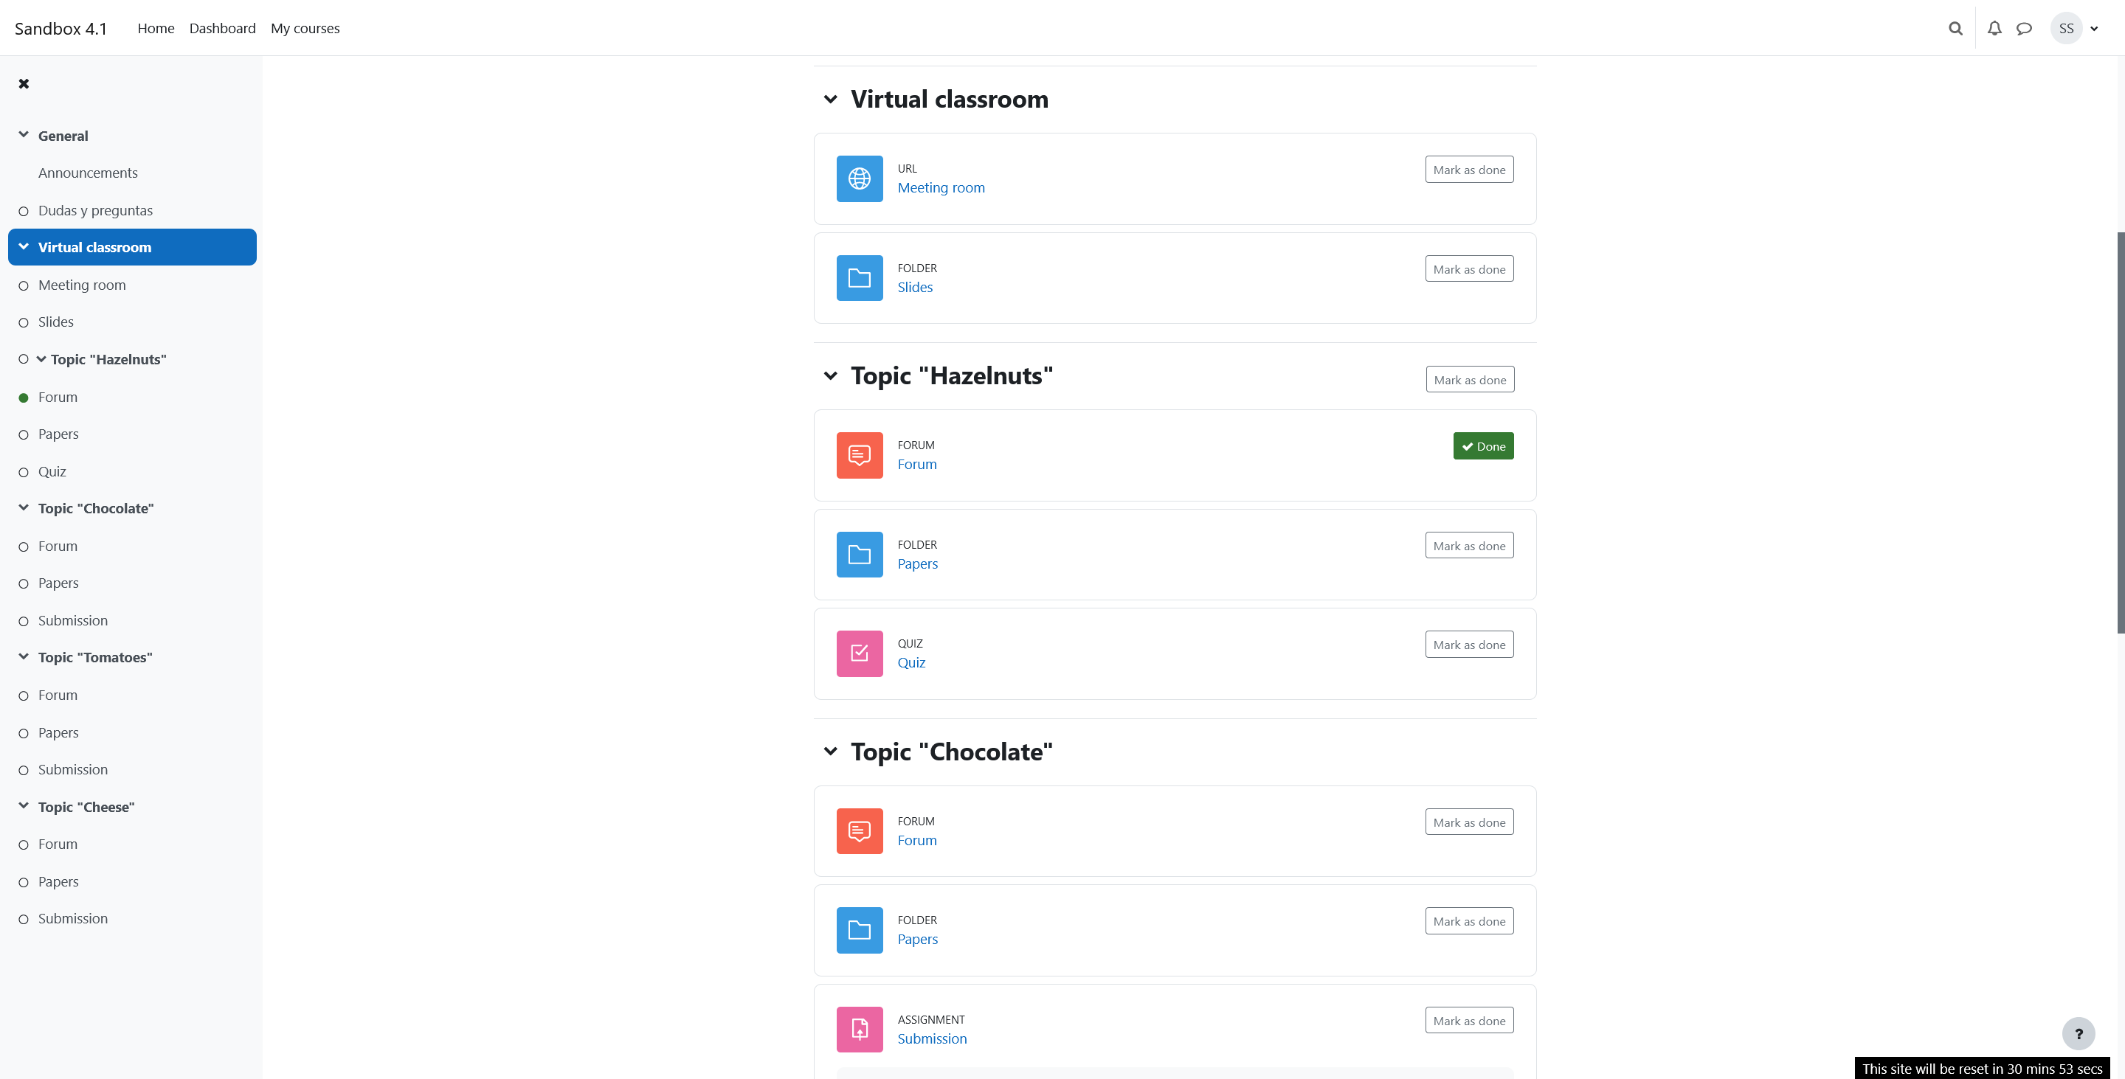
Description
As a teacher
I should be able to use the completion settings for topics/weeks
to define more flexible workflows for (automatic) learning concepts in my course.

Slide 3
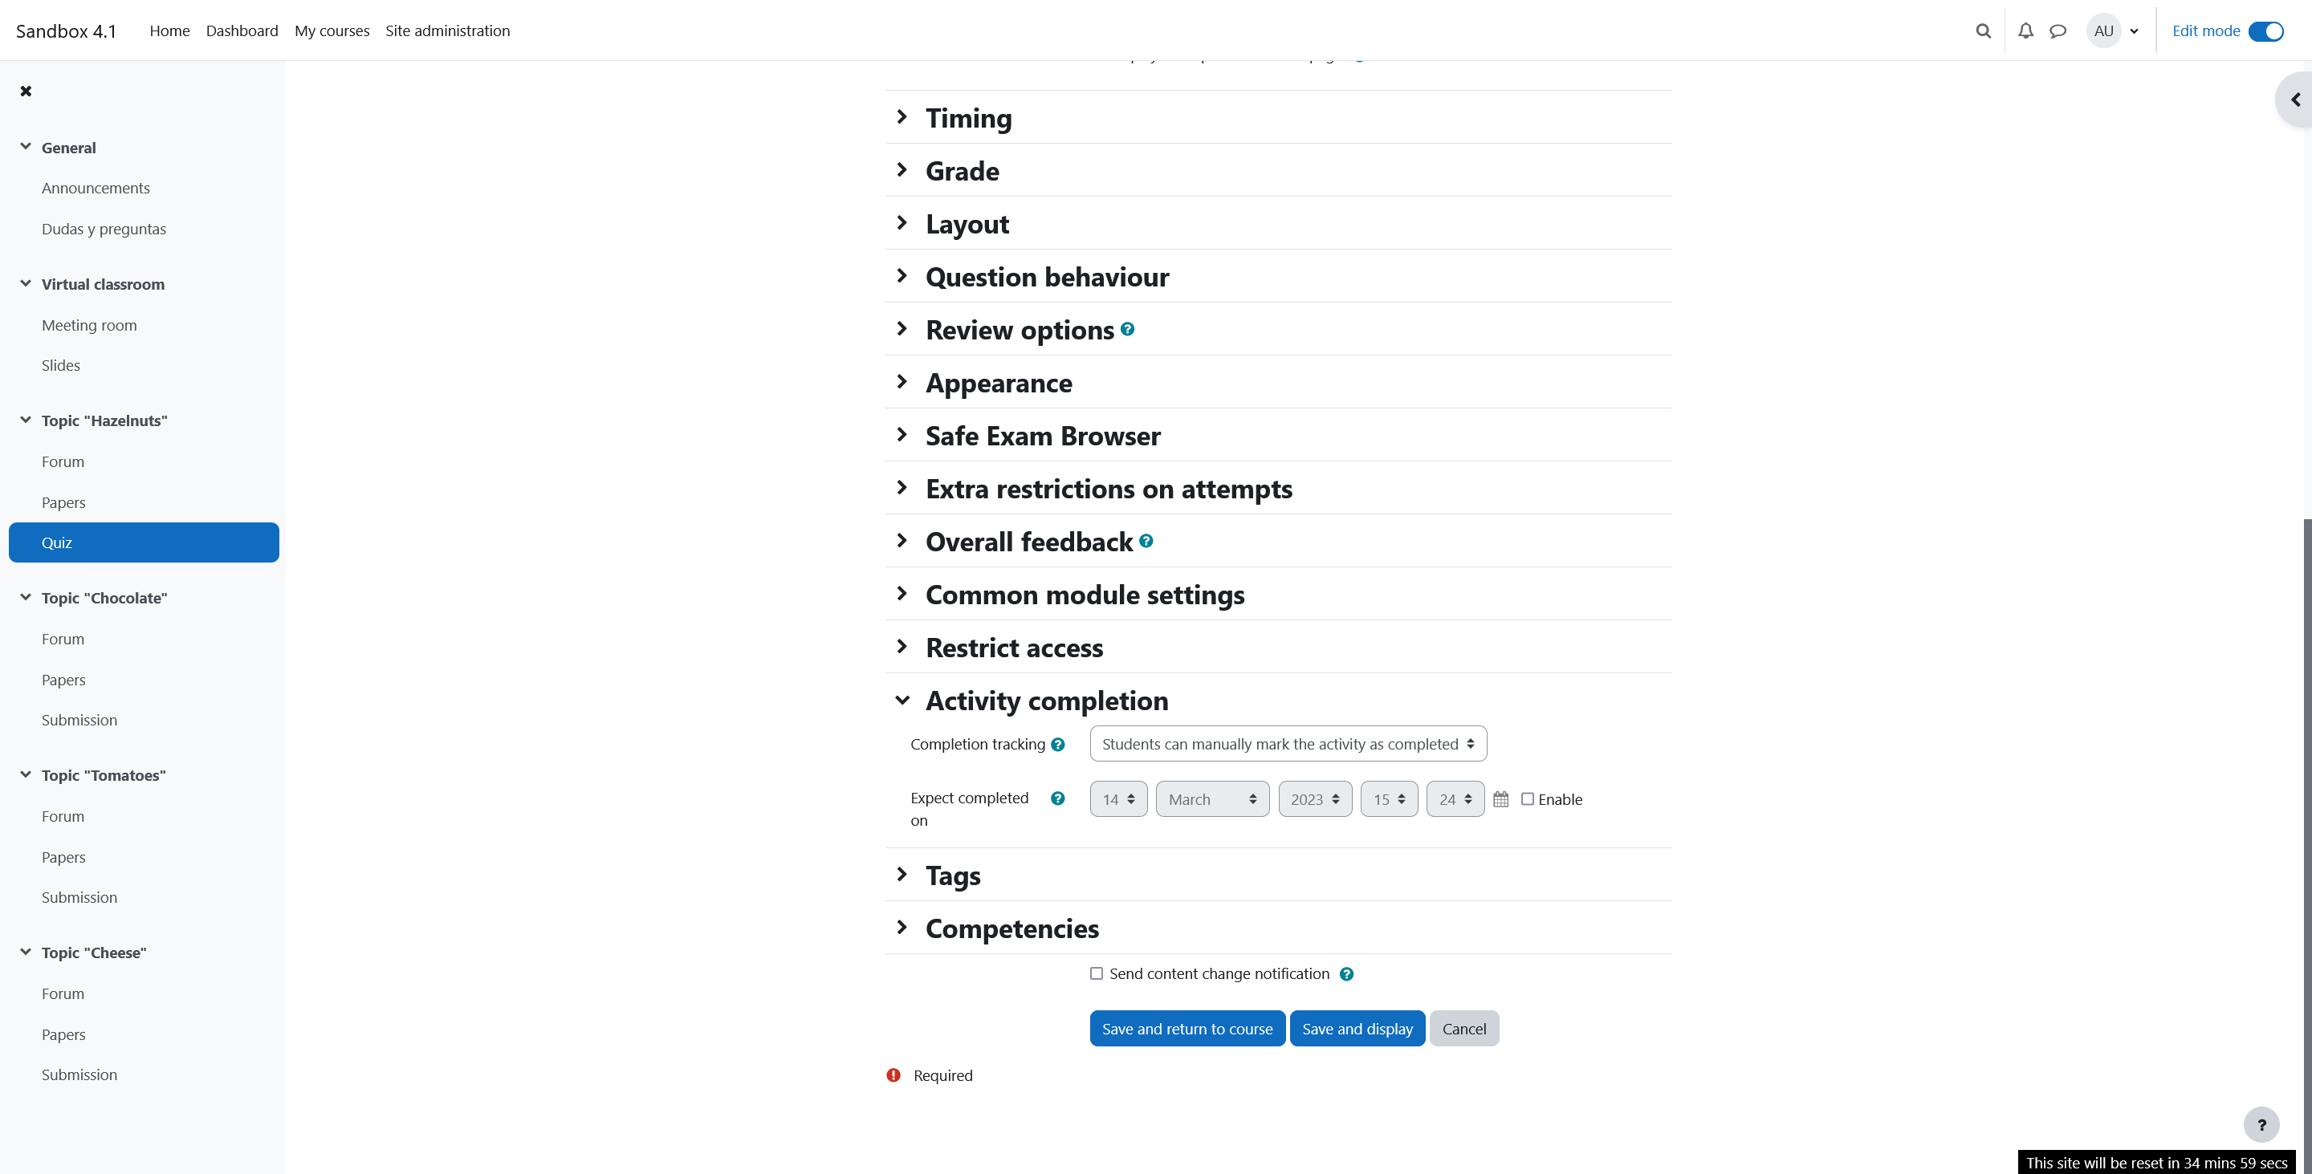
Current features
Completion settings are available for activities and materials

Slide 4
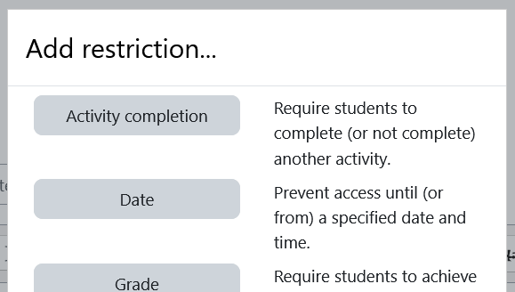
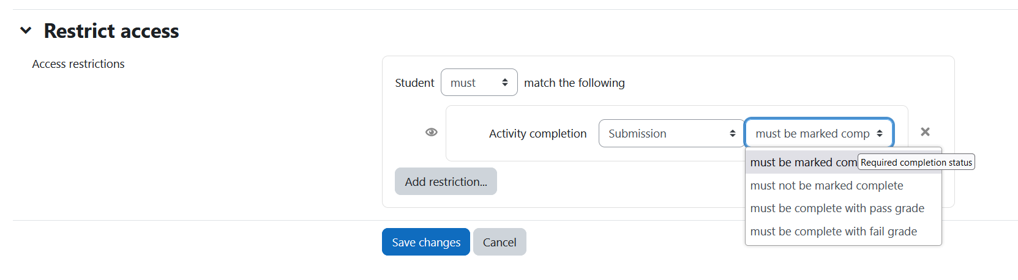
Current features
Topics/weeks can use the completion criteria of activities and materials within the access restrictions

Slide 5
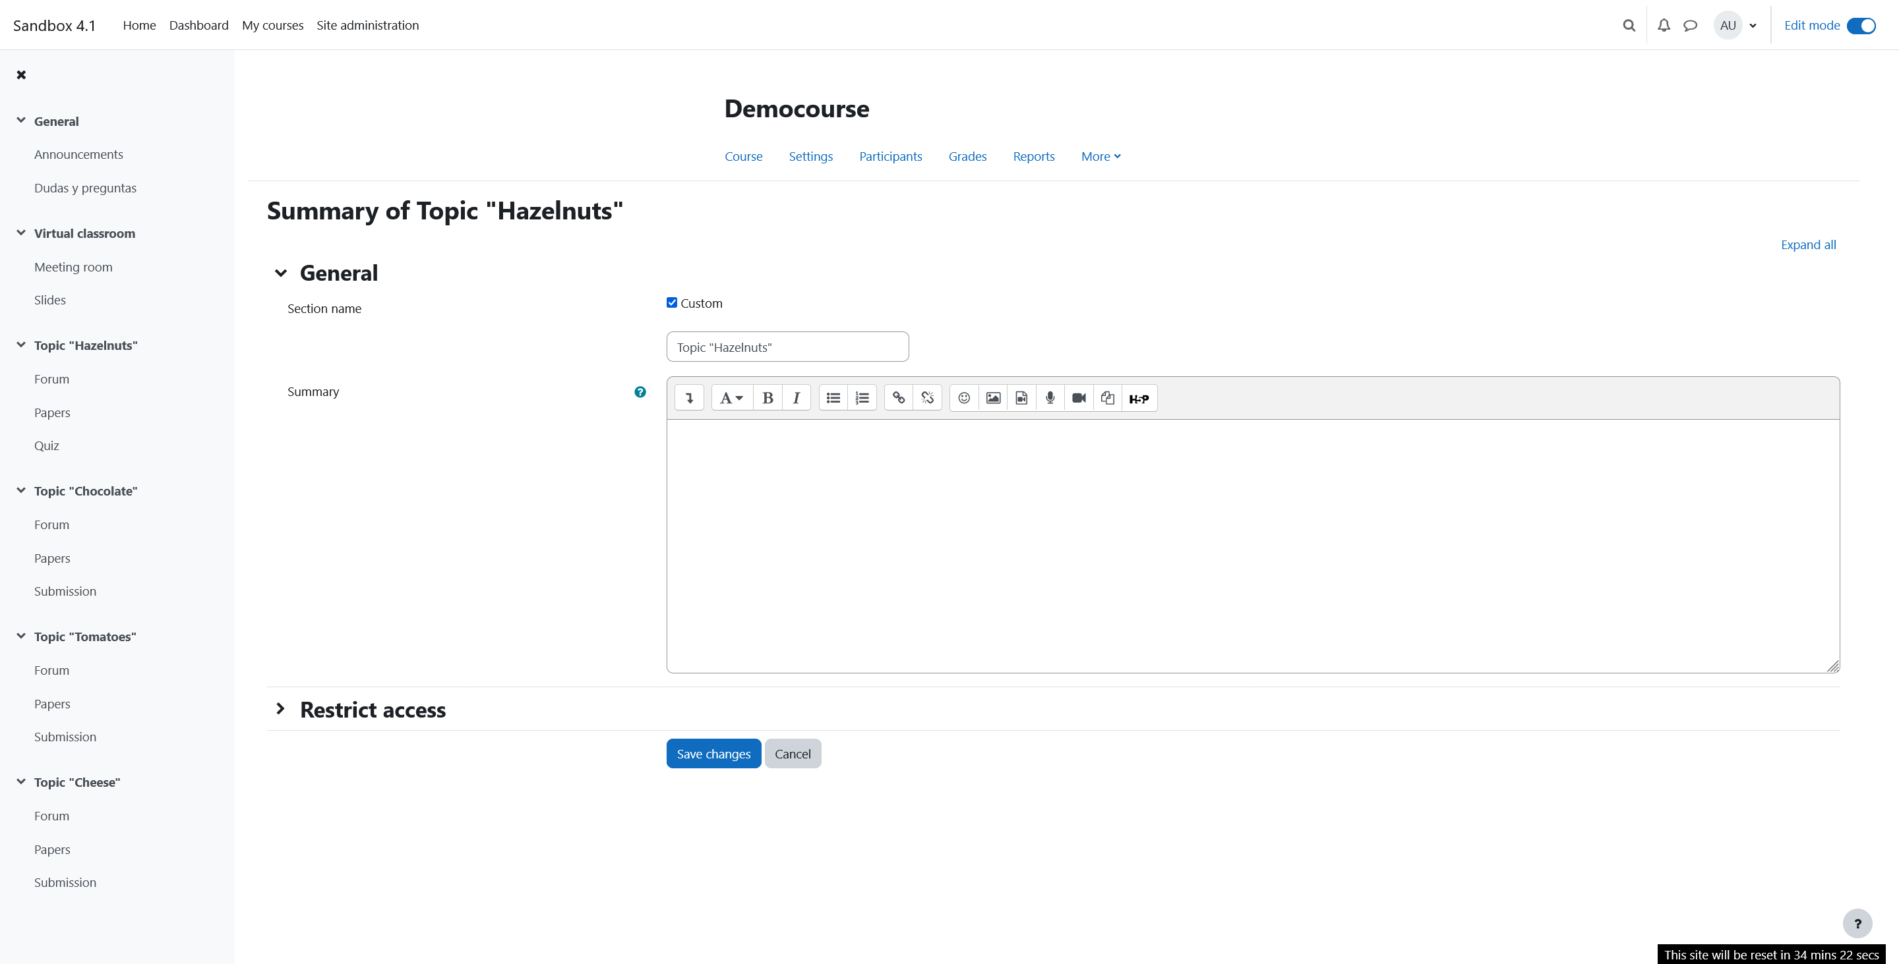
Planned features
Allow activity completion settings for topics/weeks
Use the completion status of course topics/weeks as criteria for other course element's access restrictions.
Topic completion
Students can manually mark the topic as completed

Slide 6
Planned features
Basic topic/ week completion criterias could be
  "Manual“
   students are allowed to mark the topic/week as completed manually
  "All [topic/week] elements completed“
   all current elements of this topic/week need to be completed to get the status “completed” for the topic/week too
Further completion criterias could be defined in future

Slide 7
Acceptance criteria
Completion settings for topics/weeks are available
Students can manually mark the topic/week as completed
The topic/week automatically should be marked as completed, when the defined conditions are met ( activities/materials in the topic/week are marked as completed)
The status of topic completion can be used for access restrictions

