Slide 1
Platform Issues
Results of an automatic and manual check of a Moodle course for accessibility issues (Version 4.1)
Andreas Burkard, Stuttgart Media University
Christin Stormer, Accessibility Services, University of Bielefeld

Slide 2
SHUFFLE
Higher education initiative: digital accessibility for all

Slide 3
Categorization of the test steps* (1)
Category 1: Clearly specify structure and semantics
Category 2: Facilitate navigation and orientation
Category 3: Support keyboard operation
Category 4: Offer text alternatives
Category 5: Provide subtitles & audio description for videos
Category 6: Consider colour use & text design
Category 7: Avoid animations, distractions, flickering, timeouts
interruptions
* Categories of Gottfried Zimmermann. More information: HdM Gitlab „Zwölf plus eins” (German)

Slide 4
Categorization of the test steps (2)
Category 8: Facilitate form input
Category 9: Consider mobile devices and special input methods
Category 10: Support communication via text, audio & video
Category 11: Consider support, documentation & generated content
Category 12: Support accessibility features of the platform
Category 13: Observe additional requirements of BITV & for
conformity

Slide 5
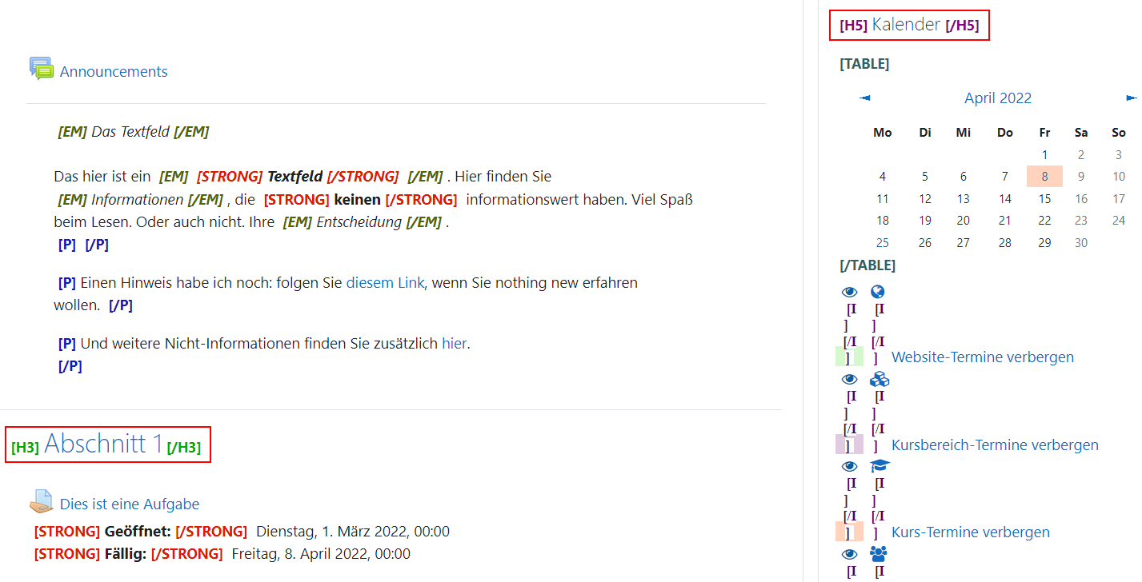
Category 1: Platform issues (1)
Customizable: 9.1.3.1 HTML structural elements
9.1.3.1a HTML structural elements for headings:
  The heading hierarchy is not coherent (even in the platform) as it skips heading levels for no reason. (Found by Siteimprove)

Slide 6
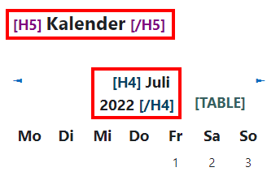
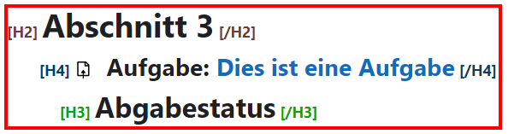
Category 1: Platform issues (2)
Customizable: 9.1.3.1 HTML structural elements
9.1.3.1a HTML structural elements for headings:
  The order of the headings is not coherent. A heading that would be subordinate to the other heading in terms of meaning has a higher heading level by mistake. (Found by Siteimprove) (New accessibility issue in Moodle 4.0)

Slide 7
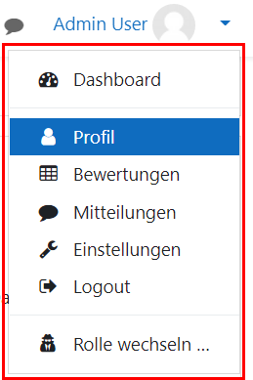
Category 1: Platform issues (3)
Customizable: 9.1.3.1 HTML structural elements
9.1.3.1b HTML structural elements for lists:
  The menu bars that open when you click either on the top right of the profile or on one of the gears are incorrectly not labelled as lists

Slide 8

Category 1: Platform issues (4)
Customizable: 9.1.3.1 HTML structural elements
9.1.3.1b HTML structural elements for lists:
  Controls that are grouped together visually and in meaning should be placed together in a list (e.g. forum and glossar).

Slide 9
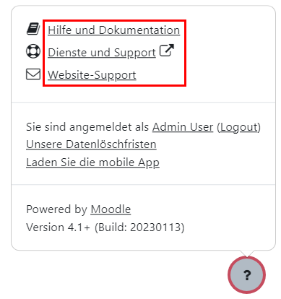
Category 1: Platform issues (5)
Customizable: 9.1.3.1 HTML structural elements
9.1.3.1b HTML structural elements for lists:
  The link list in the footer (which unfolds when you click on the question mark icon or "Show footer") is not marked as an HTML list, although it is visually and in terms of meaning a list.

Slide 10
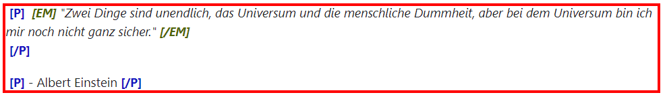
Category 1: Platform issues (6)
Customizable: 9.1.3.1 HTML structural elements
9.1.3.1c HTML structure elements for citations:
It is not possible to mark up quote blocks as <blockquote> without the HTML editor in Moodle.

Slide 11
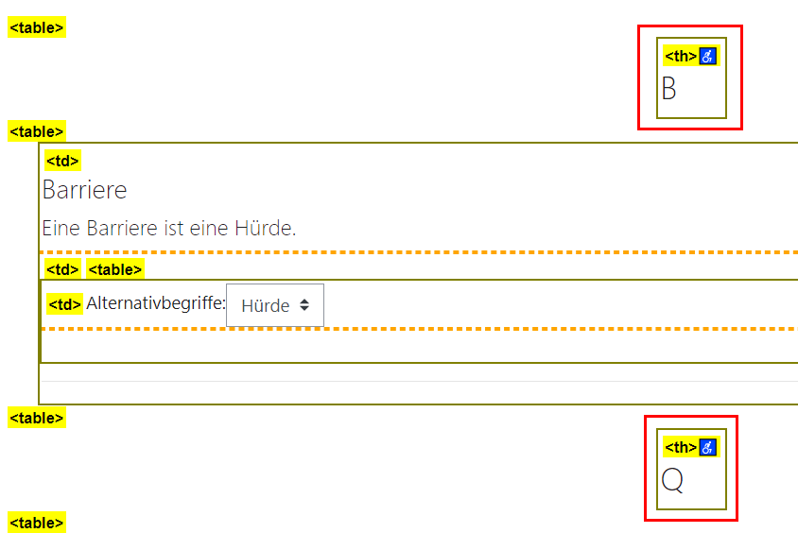
Category 1: Platform issues (7)
Customizable: 9.1.3.1 Tables
9.1.3.1e Data tables correctly structured:
Strangely enough, e.g. in the glossary several non-contiguous tables are used, some of which contain only one
element. (Found by Siteimprove)
→ Many tables inside each other should
not exist. They are read out to screen
reader users in a nested way.

Slide 12
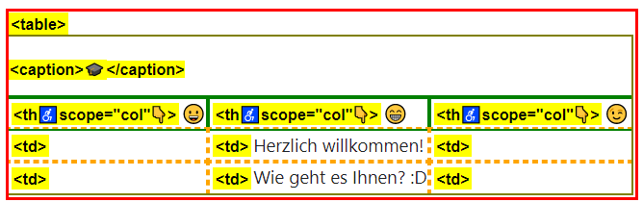
Category 1: Platform issues (8)
Customizable: 9.1.3.1 Tables
9.1.3.1g No structure markup for layout tables:
It is not possible to mark up tables as layout tables without using the HTML editor in Moodle.

Slide 13

Category 1: Platform issues (9)
Input modalities: 9.2.5
9.2.5.3 Visible labeling part of the accessible name:
  Instead of the displayed profile name, the aria label in the upper right corner has "User menu", which means that the visible label and the accessible name do not match. (Found by Siteimprove) → Screen reader users do not get read out what is visible to others

Slide 14
Category 1: Platform issues (10)
Input modalities: 9.2.5
9.2.5.3 Visible labelling part of the accessible name:
  In tables, e.g. in the forum, the names of the column headers or sort functions differ from the accessible names. E.G.: Column header "started by" instead of "sort by topic starter in descending order". (Found by Siteimprove) → Screen reader users are read something other than what is displayed or stored.

Slide 15
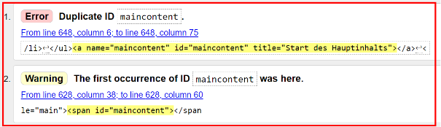
Category 1: Platform issues (11)
Compatible: 9.4.1
9.4.1.1 Syntax issue e.g.:
Validation displays the following relevant syntax issues:
  Duplicate ID (especially in the lessons). (Found by Siteimprove)

Slide 16
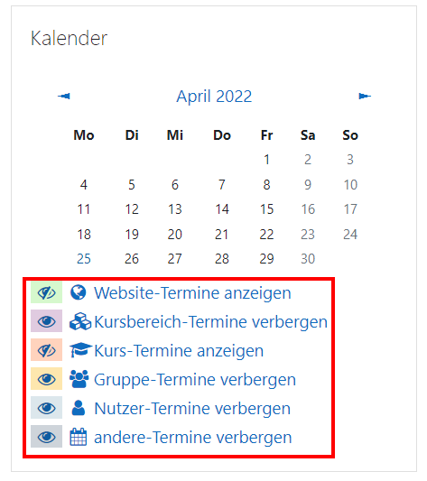
Category 1: Platform issues (12)
Compatible: 9.4.1
9.4.1.2 Name, Role, Value available:
  For the filters (icons) under the calendar, no status is output for the screen reader.
  → Here, for example, instead of icons you should either use checkboxes natively or use role="checkbox" and aria-checked with "true" or "false".

Slide 17
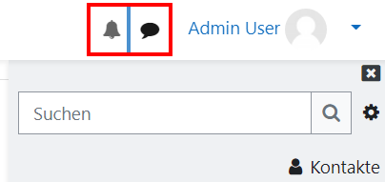
Category 1: Platform issues (13)
Compatible: 9.4.1
9.4.1.2 Name, Role, Value available:
  In the toolbar next to name and profile picture there are elements to expand that are not aria-expanded.
  On the timer of the checked video there is incorrectly role="presentation" (so it is only shown as decorative). (Found by Siteimprove)

Slide 18
Category 2: Platform issues
Navigable: 9.2.4
9.2.4.2 Meaningful document titles:
Most of the document titles on this page each contain a different, individual name of the respective page, but do not mention the name of the website.
9.2.4.5 Alternative access route:
There is only one way to add to most content pages within a course, but there should be at least two. For example via the main navigation, sitemap or the search function.

Slide 19
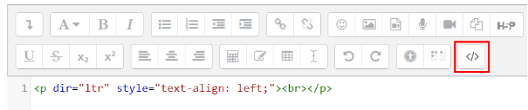
Category 3: Platform issues (1)
Accessible via keyboard: 9.2.1
9.2.1.2 No keyboard trap:
Atto Editor: Once you switch to "HTML" in the comment field, you can't get out of keyboard-only operation and you're in a keyboard trap.
→ Users who rely on keyboard operation navigate between controls by using the Tab key.

Slide 20
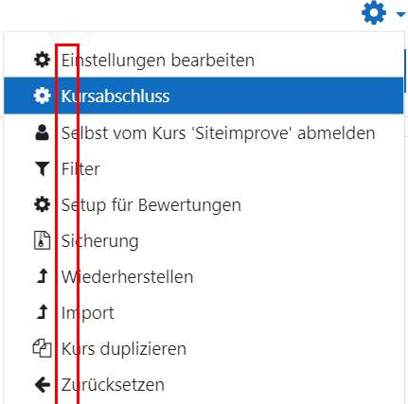
Category 3: Platform issues (2)
Accessible via keyboard: 9.2.1
9.2.1.4 Keyboard shortcuts can be disabled or customized:
In the menu bars, the first letters of the menu items are used as keyboard shortcuts, which consist of only one key and thus override the screen reader's keyboard shortcuts.

Slide 21
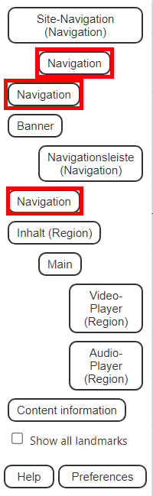
Category 3: Platform issues (3)
Navigable: 9.4.2
9.2.4.1 Bypass blocks: There are several nav elements or "navigation" landmarks. This alone is not an accessibility issue, but these need meaningful unique names per aria-label or aria-labelled by, otherwise this makes navigation difficult for screen reader users. These names are currently missing. (New accessibility issue added in Moodle 4.0)

Slide 22
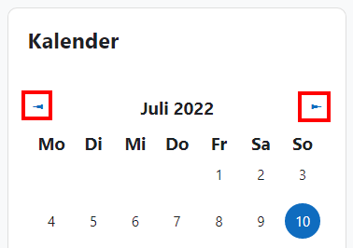
Category 4: Platform issues (1)
Text alternatives:
9.1.1.1a Alternative texts for control elements:
  Special characters such as the left arrow when switching to the last section of a task (e.g.: "◄ Task 3") should be placed in an extra <span> element and hidden from the screen reader with aria-hidden="true". Otherwise, the special characters will only cause confusion for screen reader users, since they are only there for decoration (especially since they are read out in English).

Slide 23
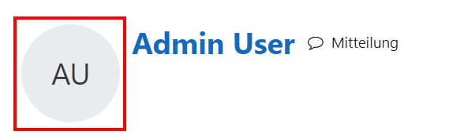
Category 4: Platform issues (2)
Text alternatives:
9.1.1.1a Alternative texts for control elements:
  The button for the profile has only the initials, but there should be an alternative text, for example per aria-label, and also contain the function. For example, for the Admin User (AU): "AU - to the Admin User's profile". (Found by Siteimprove) (new accessibility issue in Moodle 4.0)

Slide 24
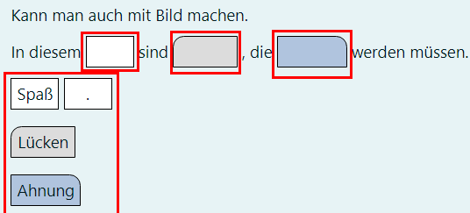
Category 4: Platform issues (3)
Text alternatives:
9.1.1.1a Alternative texts for control elements:
  The gaps in the drag & drop exercise with the gap text do not have alternative texts, only "empty" is read out by the screen reader.
  It’s very hard for Screen reader users to figure out how the task works. In addition, there should be an alternative to describe the shape and color or alternatively, for example, simply a selection list per gap as an alternative for screen reader users, where you have the possible answers to choose from.

Slide 25
Category 5: Platform issues
Video capabilities: 7.1. Subtitles
7.1.5 Spoken subtitles:
There is no option in either the YouTube player or the native Moodle player to have subtitles read aloud for videos in other languages.

Slide 26
Category 6: Platform issues
Readable: 9.3.1
9.3.1.2 Other language words and sections marked:
Except with the HTML editor, there is no way to mark up sections as English or any other language.

Slide 27
Category 7: Platform issues
Sufficient time: 9.2.2
9.2.2.2 Moving content can be switched off:
There is no way to turn off animated GIFs.

Slide 28
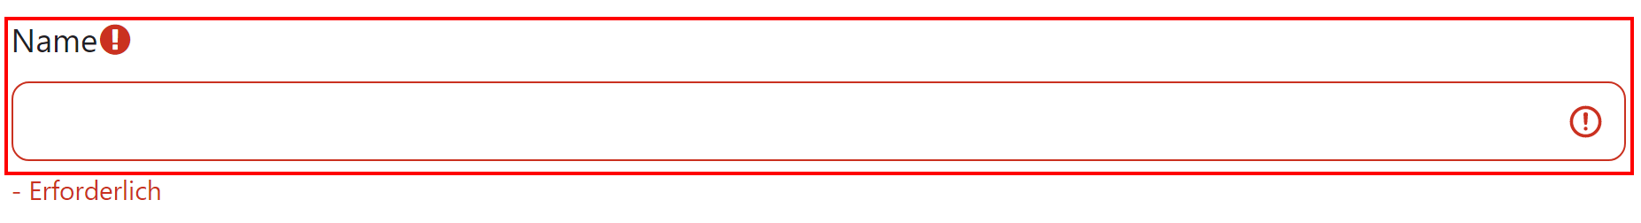
Category 8: Platform issues (1)
Customizable: 9.1.3.5
9.1.3.5 Input fields to user data convey the purpose:
There is no way in Moodle to add "autocomplete" without coding HTML.

Slide 29
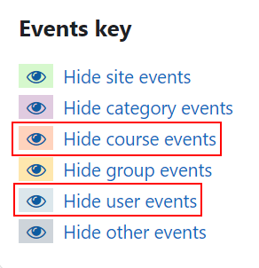
Category 8: Platform issues (2)
Compatible: 9.1.4.1
9.1.4.1 Use of colour:
In the calendar, the types of appointments can only be distinguished by different colours, so users with limitations in terms of colour perception can distinguish them poorly or not at all. - Symbols or similar should be used in addition to the colour difference.

Slide 30
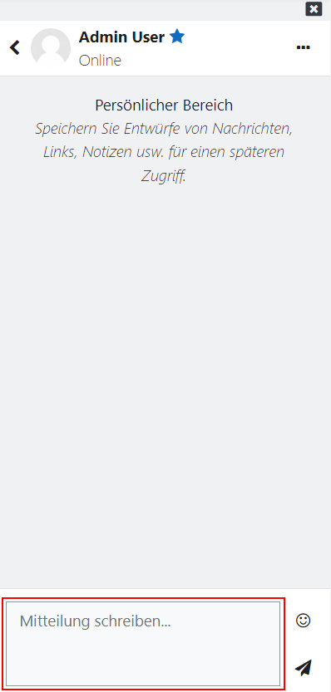

Category 8: Platform issues (3)
Assistance with the input: 9.3.3
9.3.3.2 Form element labels available:
  The <select> field to switch the user in the evaluation has no label except the default. (Image below) (New accessibility issue in Moodle 4.0)
  In the speech bubble and when you subsequently call up a conversation, the chat field only has a default value, but no sufficient label. (Image on the right)

Slide 31
Category 11: Platform issues
Authoring tools: 11.8.
11.8.3 Preservation of accessibility information during transformation:
Tables and some other elements copied over from Word (or other programs) into Moodle lose accessibility information such as table headings for tables.
11.8.5 Templates:
There are several themes, but no accessible one and none that is labeled as such.

Slide 32
Category 13: Platform issues
9.6 WCAG Conformity criteria:
Barriers caused by the platform are still to be found (see other test steps, especially those of the test steps of chapter 9).
(Found by Siteimprove)

Slide 33
7) Contact Information
SHUFFLE Homepage
Prof. Dr. Gottfried Zimmermann
Head of competence centre on digital accessibility
Stuttgart media university
zimmermanng@hdm-stuttgart.de
Andreas Burkard
Competence centre on digital accessibility
Stuttgart media university
burkard@hdm-stuttgart.de
Christin Stormer
ZAB – Accessibility Services
University of Bielefeld
Christin.Stormer@uni-bielefeld.de

